Slide 1
Advance Java
Servlet session tracking

Slide 2
Session Tracking in Servlets
Session simply means a particular interval of time.
Session Tracking is a way to maintain state (data) of an user. It is also known as session management in servlet.
Http protocol is a stateless so we need to maintain state using session tracking techniques. Each time user requests to the server, server treats the request as the new request. So we need to maintain the state of an user to recognize to particular user.
HTTP is stateless that means each request is considered as the new request. It is shown in the figure given below:

Slide 3
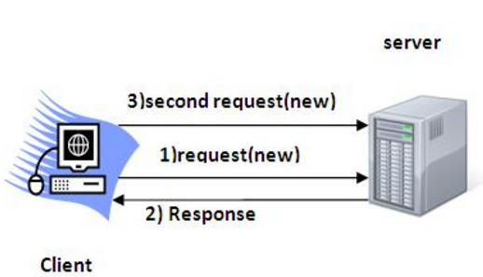
example

Slide 4
Why use Session Tracking?
To recognize the user It is used to recognize the particular user.
Session Tracking Techniques
There are four techniques used in Session tracking:
Cookies
Hidden Form Field
URL Rewriting
HttpSession

Slide 5
Cookies in Servlet
A cookie is a small piece of information that is persisted between the multiple client requests.
A cookie has a name, a single value, and optional attributes such as a comment, path and domain qualifiers, a maximum age, and a version number.

Slide 6
How Cookie works ?
By default, each request is considered as a new request. In cookies technique, we add cookie with response from the servlet. So cookie is stored in the cache of the browser. After that if request is sent by the user, cookie is added with request by default. Thus, we recognize the user as the old user.

Slide 7
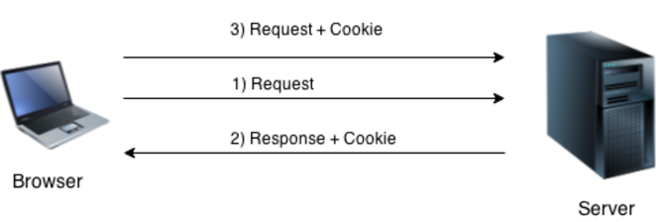
By default, each request is considered as a new request. In cookies technique, we add cookie with response from the servlet. So cookie is stored in the cache of the browser. After that if request is sent by the user, cookie is added with request by default. Thus, we recognize the user as the old user.

Slide 8
Types of Cookie
There are 2 types of cookies in servlets.
Non-persistent cookie
Persistent cookie
Non-persistent cookie
It is valid for single session only. It is removed each time when user closes the browser.
Persistent cookie
It is valid for multiple session . It is not removed each time when user closes the browser. It is removed only if user logout or signout.

Slide 9
Advantage of Cookies
Simplest technique of maintaining the state.
Cookies are maintained at client side.
Disadvantage of Cookies
It will not work if cookie is disabled from the browser.
Only textual information can be set in Cookie object.
Note: Gmail uses cookie technique for login. If you disable the cookie, gmail won't work.

Slide 10
Cookie class
javax.servlet.http.Cookie class provides the functionality of using cookies. It provides a lot of useful methods for cookies.
Constructor of Cookie class
Cookie()constructs a cookie.
Cookie(String name, String value)
constructs a cookie with a specified name and value.

Slide 11
Useful Methods of Cookie class
public void setMaxAge(int expiry)Sets the maximum age of the cookie in seconds.
public String getName()Returns the name of the cookie. The name cannot be changed after creation.
public String getValue()Returns the value of the cookie.
public void setName(String name)changes the name of the cookie.
public void setValue(String value)changes the value of the cookie.

Slide 12
Other methods required for using Cookies like
For adding cookie or getting the value from the cookie, we need some methods provided by other interfaces. They are:
public void addCookie(Cookie ck):method of HttpServletResponse interface is used to add cookie in response object.
public Cookie[] getCookies():method of HttpServletRequest interface is used to return all the cookies from the browser.

Slide 13
How to create Cookie?
Let's see the simple code to create cookie.
Cookie ck=new Cookie("user",”chetna");//creating cookie object
response.addCookie(ck);//adding cookie in the response

Slide 14
How to delete Cookie?
Let's see the simple code to delete cookie. It is mainly used to logout or signout the user.
Cookie ck=new Cookie("user","");//deleting value of cookie
ck.setMaxAge(0);//changing the maximum age to 0 seconds
response.addCookie(ck);//adding cookie in the response

Slide 15
How to get Cookies?
Let's see the simple code to get all the cookies.
Cookie ck[]=request.getCookies();
for(int i=0;i<ck.length;i++){
out.print("<br>"+ck[i].getName()+" "+ck[i].getValue());//printing name and value of cookie
}

Slide 16
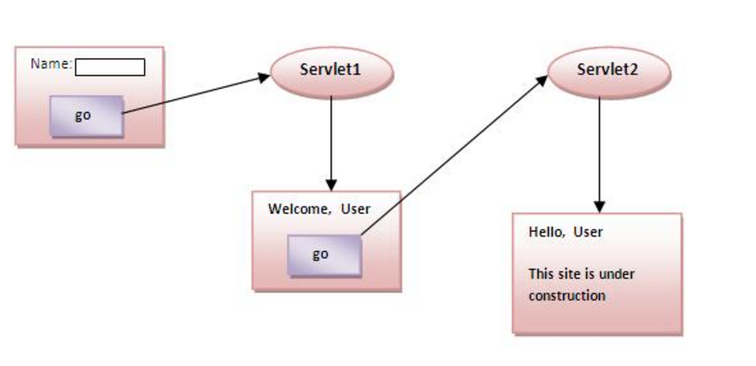
Lets understand how it work with example

Slide 17
Index.html
<form action="servlet1" method="post">
Name:<input type="text" name="userName"/><br/>
<input type="submit" value="go"/>
</form>

Slide 18
FirstServlet.java
import java.io.*;
import javax.servlet.*;
import javax.servlet.http.*;
public class FirstServlet extends HttpServlet {
public void doPost(HttpServletRequest request, HttpServletResponse response){
try{
response.setContentType("text/html");
PrintWriter out = response.getWriter();
String n=request.getParameter("userName");
out.print("Welcome "+n);

Slide 19
CONTINUE..
Cookie ck=new Cookie("uname",n);//creating cookie object
response.addCookie(ck);//adding cookie in the response
//creating submit button
out.print("<form action='servlet2'>");
out.print("<input type='submit' value='go'>");
out.print("</form>");

Slide 20
Continue..
out.close();
}catch(Exception e){System.out.println(e);}
}
}

Slide 21
SecondServlet.java
import java.io.*;
import javax.servlet.*;
import javax.servlet.http.*;
public class SecondServlet extends HttpServlet {
public void doPost(HttpServletRequest request, HttpServletResponse response){
try{
response.setContentType("text/html");
PrintWriter out = response.getWriter();

Slide 22
Cookie ck[]=request.getCookies();
out.print("Hello "+ck[0].getValue());
out.close();
}catch(Exception e){System.out.println(e);}
}
}

Slide 23
web.xml
<web-app>
<servlet>
<servlet-name>s1</servlet-name>
<servlet-class>FirstServlet</servlet-class>
</servlet>
<servlet-mapping>
<servlet-name>s1</servlet-name>
<url-pattern>/servlet1</url-pattern>
</servlet-mapping>

Slide 24
Continue…
<servlet>
<servlet-name>s2</servlet-name>
<servlet-class>SecondServlet</servlet-class>
</servlet>
<servlet-mapping>
<servlet-name>s2</servlet-name>
<url-pattern>/servlet2</url-pattern>
</servlet-mapping>
</web-app>

Slide 25
Servlet Login and Logout Example using Cookies
A cookie is a kind of information that is stored at client side.
In the previous page, we learned a lot about cookie e.g. how to create cookie, how to delete cookie, how to get cookie etc.
Here, we are going to create a login and logout example using servlet cookies.
In this example, we are creating 3 links: login, logout and profile. User can't go to profile page until he/she is logged in. If user is logged out, he need to login again to visit profile.

Slide 26
In this application, we have created
following files.
index.html
link.html
login.html
LoginServlet.java
LogoutServlet.java
ProfileServlet.java
web.xml

Slide 27
Index.html
<!DOCTYPE html>
<html>
<head>
<meta charset="ISO-8859-1">
<title>Servlet Login Example</title>
</head>
<body>
<h1>Welcome to Login App by Cookie</h1>
<a href="login.html">Login</a>|
<a href="LogoutServlet">Logout</a>|
<a href="ProfileServlet">Profile</a>
</body>
</html>

Slide 28
Link.html
<a href="login.html">Login</a> |
<a href="LogoutServlet">Logout</a> |
<a href="ProfileServlet">Profile</a>
<hr>

Slide 29
login.html
<form action="LoginServlet" method="post">
Name:<input type="text" name="name"><br>
Password:<input type="password" name="password"><br>
<input type="submit" value="login">
</form>

Slide 30
LoginServlet.java
import java.io.IOException;
import java.io.PrintWriter;
import javax.servlet.ServletException;
import javax.servlet.http.Cookie;
import javax.servlet.http.HttpServlet;
import javax.servlet.http.HttpServletRequest;
import javax.servlet.http.HttpServletResponse;
public class LoginServlet extends HttpServlet {
protected void doPost(HttpServletRequest request, HttpServletResponse response)
throws ServletException, IOException {
response.setContentType("text/html");
PrintWriter out=response.getWriter();
request.getRequestDispatcher("link.html").include(request, response);

Slide 31
Continue..
String name=request.getParameter("name");
String password=request.getParameter("password");
if(password.equals("admin123")){
out.print("You are successfully logged in!");
out.print("<br>Welcome, "+name);
Cookie ck=new Cookie("name",name);
response.addCookie(ck);
}else{
out.print("sorry, username or password error!");
request.getRequestDispatcher("login.html").include(request, response);
}
out.close();
}
}

Slide 32
LogoutServlet.java
import java.io.IOException;
import java.io.PrintWriter;
import javax.servlet.ServletException;
import javax.servlet.http.Cookie;
import javax.servlet.http.HttpServlet;
import javax.servlet.http.HttpServletRequest;
import javax.servlet.http.HttpServletResponse;
public class LogoutServlet extends HttpServlet {
protected void doGet(HttpServletRequest request, HttpServletResponse response)
throws ServletException, IOException {
response.setContentType("text/html");
PrintWriter out=response.getWriter();
request.getRequestDispatcher("link.html").include(request, response);
Cookie ck=new Cookie("name","");
ck.setMaxAge(0);
response.addCookie(ck);
out.print("you are successfully logged out!");
}
}

Slide 33
ProfileServlet.java
import java.io.IOException;
import java.io.PrintWriter;
import javax.servlet.ServletException;
import javax.servlet.http.Cookie;
import javax.servlet.http.HttpServlet;
import javax.servlet.http.HttpServletRequest;
import javax.servlet.http.HttpServletResponse;
public class ProfileServlet extends HttpServlet {
protected void doGet(HttpServletRequest request, HttpServletResponse response)
throws ServletException, IOException {
response.setContentType("text/html");
PrintWriter out=response.getWriter();
request.getRequestDispatcher("link.html").include(request, response);
Cookie ck[]=request.getCookies();

Slide 34
Continue…
if(ck!=null){
String name=ck[0].getValue();
if(!name.equals("")||name!=null){
out.print("<b>Welcome to Profile</b>");
out.print("<br>Welcome, "+name);
}
}else{
out.print("Please login first");
request.getRequestDispatcher("login.html").include(request, response);
}
out.close();
}
}

Slide 35
web.xml
<web-app xmlns:xsi="http://www.w3.org/2001/XMLSchema-instance"
xmlns="http://java.sun.com/xml/ns/javaee" xsi:schemaLocation="http://java.sun.com/xml/ns/javaee
http://java.sun.com/xml/ns/javaee/web-app_2_5.xsd" id="WebApp_ID" version="2.5">
<servlet>
<description></description>
<display-name>LoginServlet</display-name>
<servlet-name>LoginServlet</servlet-name>
<servlet-class>LoginServlet</servlet-class>
</servlet>
<servlet-mapping>
<servlet-name>LoginServlet</servlet-name>
<url-pattern>/LoginServlet</url-pattern>
</servlet-mapping>
<servlet>

Slide 36
Continue..
<description></description>
<display-name>ProfileServlet</display-name>
<servlet-name>ProfileServlet</servlet-name>
<servlet-class>ProfileServlet</servlet-class>
</servlet>
<servlet-mapping>
<servlet-name>ProfileServlet</servlet-name>
<url-pattern>/ProfileServlet</url-pattern>
</servlet-mapping>

Slide 37
Continue…
<servlet>
<description></description>
<display-name>LogoutServlet</display-name>
<servlet-name>LogoutServlet</servlet-name>
<servlet-class>LogoutServlet</servlet-class>
</servlet>
<servlet-mapping>
<servlet-name>LogoutServlet</servlet-name>
<url-pattern>/LogoutServlet</url-pattern>
</servlet-mapping>
</web-app>

Slide 38
2) Hidden Form Field
In case of Hidden Form Field a hidden (invisible) textfield is used for maintaining the state of an user.
In such case, we store the information in the hidden field and get it from another servlet. This approach is better if we have to submit form in all the pages and we don't want to depend on the browser.
Let's see the code to store value in hidden field.
<input type="hidden" name="uname" value=“chetana">
Here, uname is the hidden field name and chetana is the hidden field value.

Slide 39
Real application of hidden form field
It is widely used in comment form of a website. In such case, we store page id or page name in the hidden field so that each page can be uniquely identified.

Slide 40
Advantage of Hidden Form Field
It will always work whether cookie is disabled or not.
Disadvantage of Hidden Form Field:
It is maintained at server side.
Extra form submission is required on each pages.
Only textual information can be used.

Slide 41
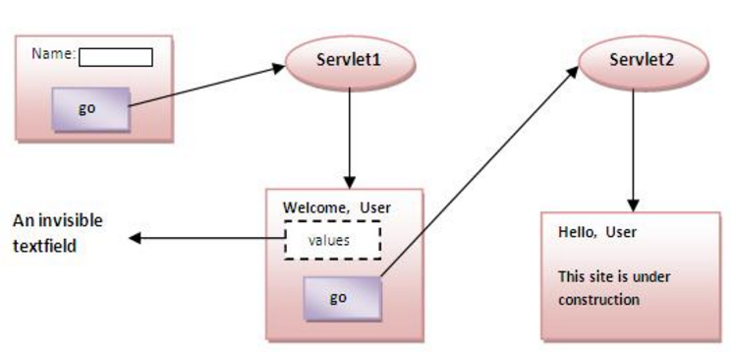
Example of using Hidden Form Field
In this example, we are storing the name of the user in a hidden textfield and getting that value from another servlet.

Slide 42
index.html
<form action="servlet1">
Name:<input type="text" name="userName"/><br/>
<input type="submit" value="go"/>
</form>

Slide 43
FirstServlet.java
import java.io.*;
import javax.servlet.*;
import javax.servlet.http.*;
public class FirstServlet extends HttpServlet {
public void doGet(HttpServletRequest request, HttpServletResponse response){
try{
response.setContentType("text/html");
PrintWriter out = response.getWriter();
String n=request.getParameter("userName");
out.print("Welcome "+n);

Slide 44
Continuee…
//creating form that have invisible textfield
out.print("<form action='servlet2'>");
out.print("<input type='hidden' name='uname' value='"+n+"'>");
out.print("<input type='submit' value='go'>");
out.print("</form>");
out.close();
}catch(Exception e){System.out.println(e);}
}
}

Slide 45
SecondServlet.java
import java.io.*;
import javax.servlet.*;
import javax.servlet.http.*;
public class SecondServlet extends HttpServlet {
public void doGet(HttpServletRequest request, HttpServletResponse response)
try{
response.setContentType("text/html");
PrintWriter out = response.getWriter();
//Getting the value from the hidden field
String n=request.getParameter("uname");
out.print("Hello "+n);
out.close();
}catch(Exception e){System.out.println(e);}
}
}

Slide 46
web.xml
<web-app>
<servlet>
<servlet-name>s1</servlet-name>
<servlet-class>FirstServlet</servlet-class>
</servlet>
<servlet-mapping>
<servlet-name>s1</servlet-name>
<url-pattern>/servlet1</url-pattern>
</servlet-mapping>

Slide 47
Continue…
<servlet>
<servlet-name>s2</servlet-name>
<servlet-class>SecondServlet</servlet-class>
</servlet>
<servlet-mapping>
<servlet-name>s2</servlet-name>
<url-pattern>/servlet2</url-pattern>
</servlet-mapping>
</web-app>

Slide 48
3)URL Rewriting
In URL rewriting, we append a token or identifier to the URL of the next Servlet or the next resource. We can send parameter name/value pairs using the following format:
url?name1=value1&name2=value2&??
A name and a value is separated using an equal = sign, a parameter name/value pair is separated from another parameter using the ampersand(&). When the user clicks the hyperlink, the parameter name/value pairs will be passed to the server.
From a Servlet, we can use getParameter() method to obtain a parameter value.

Slide 49
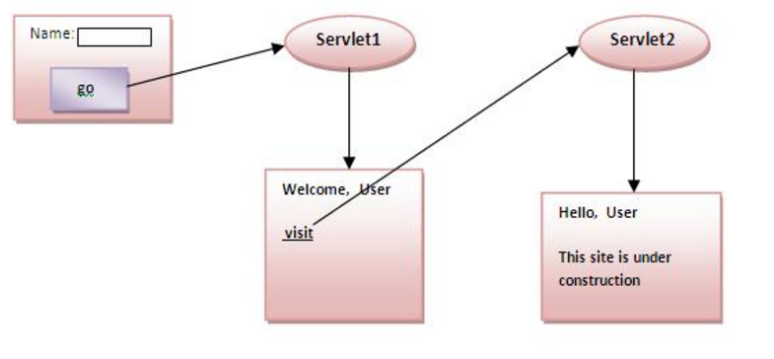

Slide 50
Continue…
Advantage of URL Rewriting
It will always work whether cookie is disabled or not (browser independent).
Extra form submission is not required on each pages.
Disadvantage of URL Rewriting
It will work only with links.
It can send Only textual information.

Slide 51
Example of using URL Rewriting
In this example, we are maintaning the state of the user using link. For this purpose, we are appending the name of the user in the query string and getting the value from the query string in another page.

Slide 52
index.html
<form action="servlet1">
Name:<input type="text" name="userName"/><br/>
<input type="submit" value="go"/>
</form>

Slide 53
FirstServlet.java
import java.io.*;
import javax.servlet.*;
import javax.servlet.http.*;
public class FirstServlet extends HttpServlet {
public void doGet(HttpServletRequest request, HttpServletResponse response){
try{
response.setContentType("text/html");
PrintWriter out = response.getWriter();
String n=request.getParameter("userName");

Slide 54
Continue…
out.print("Welcome "+n);
//appending the username in the query string
out.print("<a href='servlet2?uname="+n+“'>visit</a>");
out.close();
}catch(Exception e){System.out.println(e);}
}
}

Slide 55
SecondServlet.java
import java.io.*;
import javax.servlet.*;
import javax.servlet.http.*;
public class SecondServlet extends HttpServlet {
public void doGet(HttpServletRequest request, HttpServletResponse response)
try{
response.setContentType("text/html");
PrintWriter out = response.getWriter();
//getting value from the query string
String n=request.getParameter("uname");
out.print("Hello "+n);
out.close();
}catch(Exception e){System.out.println(e);}
}
}

Slide 56
web.xml
<web-app>
<servlet>
<servlet-name>s1</servlet-name>
<servlet-class>FirstServlet</servlet-class>
</servlet>
<servlet-mapping>
<servlet-name>s1</servlet-name>
<url-pattern>/servlet1</url-pattern>
</servlet-mapping>
<servlet>
<servlet-name>s2</servlet-name>
<servlet-class>SecondServlet</servlet-class>
</servlet>
<servlet-mapping>
<servlet-name>s2</servlet-name>
<url-pattern>/servlet2</url-pattern>
</servlet-mapping>
</web-app>

Slide 57
4) HttpSession interface
In such case, container creates a session id for each user.The container uses this id to identify the particular user.An object of HttpSession can be used to perform two tasks:
bind objects
view and manipulate information about a session, such as the session identifier, creation time, and last accessed time.

Slide 58
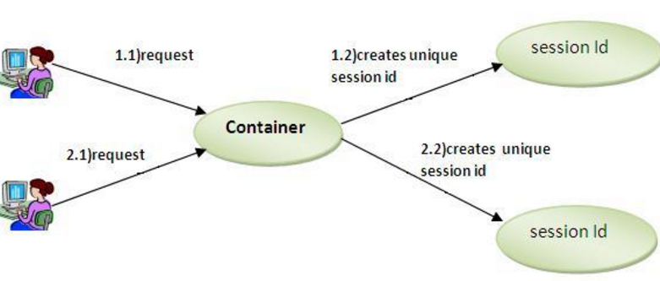
Continue…

Slide 59
How to get the HttpSession object ?
The HttpServletRequest interface provides two methods to get the object of HttpSession:
public HttpSession getSession():Returns the current session associated with this request, or if the request does not have a session, creates one.
public HttpSession getSession(boolean create):Returns the current HttpSession associated with this request or, if there is no current session and create is true, returns a new session.
Commonly used methods of HttpSession interface
public String getId():Returns a string containing the unique identifier value.
public long getCreationTime():Returns the time when this session was created, measured in milliseconds since midnight January 1, 1970 GMT.
public long getLastAccessedTime():Returns the last time the client sent a request associated with this session, as the number of milliseconds since midnight January 1, 1970 GMT.
public void invalidate():Invalidates this session then unbinds any objects bound to it.

Slide 60
Example of using HttpSession
In this example, we are setting the attribute in the session scope in one servlet and getting that value from the session scope in another servlet. To set the attribute in the session scope, we have used the setAttribute() method of HttpSession interface and to get the attribute, we have used the getAttribute method.

Slide 61
Index.html
<form action="servlet1">
Name:<input type="text" name="userName"/><br/>
<input type="submit" value="go"/>
</form>

Slide 62
FirstServlet.java
import java.io.*;
import javax.servlet.*;
import javax.servlet.http.*;
public class FirstServlet extends HttpServlet {
public void doGet(HttpServletRequest request, HttpServletResponse response){
try{
response.setContentType("text/html");
PrintWriter out = response.getWriter();
String n=request.getParameter("userName");

Slide 63
Continue…
out.print("Welcome "+n);
HttpSession session=request.getSession();
session.setAttribute("uname",n);
out.print("<a href='servlet2'>visit</a>");
out.close();
}catch(Exception e){System.out.println(e);}
}
}

Slide 64
SecondServlet.java
import java.io.*;
import javax.servlet.*;
import javax.servlet.http.*;
public class SecondServlet extends HttpServlet {
public void doGet(HttpServletRequest request, HttpServletResponse response)
try{
response.setContentType("text/html");
PrintWriter out = response.getWriter();
HttpSession session=request.getSession(false);
String n=(String)session.getAttribute("uname");
out.print("Hello "+n);
out.close();
}catch(Exception e){System.out.println(e);}
}
}

Slide 65
Web.xml
<web-app>
<servlet>
<servlet-name>s1</servlet-name>
<servlet-class>FirstServlet</servlet-class>
</servlet>
<servlet-mapping>
<servlet-name>s1</servlet-name>
<url-pattern>/servlet1</url-pattern>
</servlet-mapping>
<servlet>
<servlet-name>s2</servlet-name>
<servlet-class>SecondServlet</servlet-class>
</servlet>
<servlet-mapping>
<servlet-name>s2</servlet-name>
<url-pattern>/servlet2</url-pattern>
</servlet-mapping>
</web-app>

Slide 66
Servlet HttpSession Login and Logout Example
We can bind the objects on HttpSession instance and get the objects by using setAttribute and getAttribute methods.
In the previous page, we have learnt about what is HttpSession, How to store and get data from session object etc.
Here, we are going to create a real world login and logout application without using database code. We are assuming that password is admin123.

Slide 67
Example
In this example, we are creating 3 links: login, logout and profile. User can't go to profile page until he/she is logged in. If user is logged out, he need to login again to visit profile.
In this application, we have created following files.
index.html
link.html
login.html
LoginServlet.java
LogoutServlet.java
ProfileServlet.java
web.xml

Slide 68
Index.html
<!DOCTYPE html>
<html>
<head>
<meta charset="ISO-8859-1">
<title>Servlet Login Example</title>
</head>
<body>
<h1>Login App using HttpSession</h1>
<a href="login.html">Login</a>|
<a href="LogoutServlet">Logout</a>|
<a href="ProfileServlet">Profile</a>
</body>
</html>

Slide 69
link.html
<a href="login.html">Login</a> |
<a href="LogoutServlet">Logout</a> |
<a href="ProfileServlet">Profile</a>
<hr>

Slide 70
File: login.html
<form action="LoginServlet" method="post">
Name:<input type="text" name="name"><br>
Password:<input type="password" name="password"><br>
<input type="submit" value="login">
</form>

Slide 71
LoginServlet.java
import java.io.IOException;
import java.io.PrintWriter;
import javax.servlet.ServletException;
import javax.servlet.http.HttpServlet;
import javax.servlet.http.HttpServletRequest;
import javax.servlet.http.HttpServletResponse;
import javax.servlet.http.HttpSession;
public class LoginServlet extends HttpServlet {
protected void doPost(HttpServletRequest request, HttpServletResponse response)
throws ServletException, IOException {
response.setContentType("text/html");
PrintWriter out=response.getWriter();
request.getRequestDispatcher("link.html").include(request, response);
String name=request.getParameter("name");
String password=request.getParameter("password");

Slide 72
Continue…
if(password.equals("admin123")){
out.print("Welcome, "+name);
HttpSession session=request.getSession();
session.setAttribute("name",name);
}
else{
out.print("Sorry, username or password error!");
request.getRequestDispatcher("login.html").include(request, response);
}
out.close();
}
}

Slide 73
LogoutServlet.java
import java.io.IOException;
import java.io.PrintWriter;
import javax.servlet.ServletException;
import javax.servlet.http.HttpServlet;
import javax.servlet.http.HttpServletRequest;
import javax.servlet.http.HttpServletResponse;
import javax.servlet.http.HttpSession;
public class LogoutServlet extends HttpServlet {
protected void doGet(HttpServletRequest request, HttpServletResponse response)
throws ServletException, IOException {
response.setContentType("text/html");
PrintWriter out=response.getWriter();
request.getRequestDispatcher("link.html").include(request, response);
HttpSession session=request.getSession();
session.invalidate();

Slide 74
Continue…
out.print("You are successfully logged out!");
out.close();
}
}

Slide 75
ProfileServlet.java
import java.io.IOException;
import java.io.PrintWriter;
import javax.servlet.ServletException;
import javax.servlet.http.HttpServlet;
import javax.servlet.http.HttpServletRequest;
import javax.servlet.http.HttpServletResponse;
import javax.servlet.http.HttpSession;
public class ProfileServlet extends HttpServlet {
protected void doGet(HttpServletRequest request, HttpServletResponse response)
throws ServletException, IOException {
response.setContentType("text/html");
PrintWriter out=response.getWriter();
request.getRequestDispatcher("link.html").include(request, response);

Slide 76
Continue…
HttpSession session=request.getSession(false);
if(session!=null){
String name=(String)session.getAttribute("name");
out.print("Hello, "+name+" Welcome to Profile");
}
else{
out.print("Please login first");
request.getRequestDispatcher("login.html").include(request, response);
}
out.close();
}
}

Slide 77
Web.xml
<servlet>
<description></description>
<display-name>LoginServlet</display-name>
<servlet-name>LoginServlet</servlet-name>
<servlet-class>LoginServlet</servlet-class>
</servlet>
<servlet-mapping>
<servlet-name>LoginServlet</servlet-name>
<url-pattern>/LoginServlet</url-pattern>
</servlet-mapping>
<servlet>
<description></description>
<display-name>ProfileServlet</display-name>
<servlet-name>ProfileServlet</servlet-name>
<servlet-class>ProfileServlet</servlet-class>

Slide 78
Continue…
</servlet>
<servlet-mapping>
<servlet-name>ProfileServlet</servlet-name>
<url-pattern>/ProfileServlet</url-pattern>
</servlet-mapping>
<servlet>
<description></description>
<display-name>LogoutServlet</display-name>
<servlet-name>LogoutServlet</servlet-name>
<servlet-class>LogoutServlet</servlet-class>
</servlet>
<servlet-mapping>
<servlet-name>LogoutServlet</servlet-name>
<url-pattern>/LogoutServlet</url-pattern>
</servlet-mapping>
</web-app>

